Slide 1


Dwarkadas J. Sanghvi College of Engineering
Department of Computer Engineering
2025-26
MEME: Meaning Evolution Through Media and Events
Under the guidance of
Prof. Pranit Bari
Project Guide
Rashi Rana
60004220175(C129)
Vanshika Dhruv
60004220091(C171)
Vruddhi Shah
60004220215(C186)

Slide 2
Table of Contents
Introduction and Need of the Project
Problem Statement
Motivation
Scope of the Project
Proposed Methodology
System Architecture
Implementation Details
Results
Literature Review
Future Work
References

Slide 3
02
Problem Statement

Slide 4
Current methods for tracking word meanings change over time only look at how the word is used by people in text.
These fail to take into consideration the real-world events that drive those changes.
They only notice the effect (semantic shift) without explaining the cause (events)
For example for the word “lockdown”
Pre-2020: Used in prison context, surrounded by words like “jail”, “inmates”, “security”
After-2020: Used in staying at home context, surrounded by words like “pandemic”, “COVID”, “home”
Events include: political crises, pop(ular) culture phenomena and technological advances
The development of a novel, event-aware metric is essential to accurately measure semantic change

Slide 5
01
Introduction and
Need of the Project

Slide 6
Words do not mean the same forever. Semantic shift is a form of language change such that the modern meaning of a word is substantially different from when it was coined. Examples include:
Word | Event | Old meaning | New meaning
Viral | Social media boom | Medical term | Content spreading on social media
Tweet | Launch of the social media platform Twitter | Sound made by birds | Posting on Twitter
Cloud | Cloud computing | Weather-related term | Online data storage
Notes:
tracking these shifts helps us understand how people think and communicate over time

Slide 7
Lexical Semantic Change (LSC) refers to how word meanings evolve over time.
In modern corpora, semantic change is often triggered or accelerated by real-world events such as pandemics, technological booms, or cultural trends.
If computers assume meanings are fixed, text misunderstanding can happen.
As a result, understanding how and why word meanings change is an important problem in linguistics and natural language processing (NLP).
Tracking such changes is critical as language today evolves rapidly especially with the influence of social media, technology and global events.
Notes:
tracking these shifts helps us understand how people think and communicate over time

Slide 8
Applications
Natural language processing (NLP)
Search Engine Optimisation (SEO)
Social Media and Trend Analysis
Fairness in AI models
Content Moderation
Machine Translation
Sentiment Analysis
Event Detection and Monitoring
Notes:
Query interpretation (SEO eg) and also helps with document ranking
User searches: “bubble rules”
Text-only engine: mixes finance + health results Event-aware engine: checks time or user context AND sees that bubble has an event-linked shift If query time = 2020–2021: interpret bubble as COVID social bubble If query time = 2008: interpret bubble as economic bubble This metric helps the engine choose the right meaning.

Slide 9
05
Scope of the Project

Slide 10
To directly connect meaning evolution with real-world events and understand the why behind semantic shift
Design an event-aware, alignment-free family of semantic shift metrics
Decompose semantic change into short-term disruption and long-term drift
Evaluate across different language registers (formal vs. informal) and temporal data to ensure consistent and reliable detection of semantic shifts.
Compare performance and consistency against existing metrics.

Slide 11
04
Motivation

Slide 12
Existing metrics
Cosine Mean: Checks how much the overall meaning of a word changes over time.
UOT Shift: Checks whether new meanings appear, old meanings disappear, or usage changes a lot.
Wasserstein Shift: Checks how existing meanings slowly move or shift, without adding new ones.
Context Entropy Shift: Checks whether a word’s meaning becomes more narrow or more broad.
Notes:
UOT - how probability mass moves
cosine - mostly done as aggregating
wasserstein - assumption ki no new meanings
entropy - how diverse a words contexts are

Slide 13
Common assumptions in existing methods
Semantic change = distance between t1​ and t2​
Meanings within a time period are stable
Temporal information is implicit
Limitations:
Temporal collapse : Short-term shocks and long-term drift are merged
Forced sense tracking: Clustering + alignment is noisy and unstable
Binary temporal framing: Benchmarks limited to 1–2 time periods
Lack of event awareness: Real-world triggers ignored
Scalability & robustness issues: Sensitive to frequency imbalance and domain shifts.
Notes:
binning is done
time not explicitly modeled
To track semantic change we must decide which cluster in t₂ corresponds to which cluster in t₁ This is called alignment
Alignment across time os brittle because A cluster in t₁ may split into two in t₂, merge with another, shift position without changing meaning
Example of alignment - centroid vectors me cosine similarity

Slide 14
06
Proposed Methodology

Slide 15
Dataset collection: Collect both formal and informal corpora, and divide into “before, during, after” event windows.
Embedding extraction: Generate contextual embeddings for each word occurrence for the target words.
Baseline comparison: Compute traditional metrics for baseline comparison
Event aware metric design: Decompose semantic change into long-term semantic divergence short-term event impact. Combine components into multiple metric variants
Evaluation and analysis: Compare the proposed metric’s consistency, robustness, and interpretability with baseline metrics.

Slide 16
07
System Architecture

Slide 17
Language Model
Semantic
Divergence
Embedding Generation
Divergence
Calculations
Event Impact
Overall Metric
Calculation
Register Shift
Live Data Stream
Temporal Segmentation

Slide 18
08
Implementation Details

Slide 19
Initial Hypothesis Validation
Dataset: English TempoWiC (tuples of tweets containing target word, 12-month gap)
Model: sentence-transformers/all-MiniLM-L6-v2
Different metrics capture different semantic phenomena:
Cosine mean reflects overall vector movement in embedding space
UOT models reallocation of sense probability mass, they are more sensitive to polysemy and sense dominance changes.
Wasserstein compares distributions
Entropy shift captures contextual spread (diversity), not direction or mass movement
Weak inter-metric correlations confirm unreliability of current shift quantification.
Notes:
different most changed wordsr

Slide 20
Event-aware dataset creation
Identified 30 target events
Selected target words likely to shift meaning during or after those events.
Selected control words that likely do not shift meaning through history
Collected formal data from newspaper archives and informal data from social media dumps, which we divided into:
Before, During, and After periods for long-term events.
Before and After periods for instantaneous events (e.g., major announcements).
Generated contextual embeddings using sentence-transformers/all-MiniLM-L6-v2
Each occurrence of a target word embedded independently and stored
Notes:
looking for more data, 10 distinct events, 15 specific words, 1000 sentences per word

Slide 21
Baseline metric analysis
Applied baseline metrics on the dataset:
Cosine Mean: Captures dominant sense movement
Average Pairwise Distance (APD): Sensitive to usage dispersion and polysemy
Entropy Shift: Measures contextual diversity
Conclusions:
Cosine and APD capture different semantic signals
Negative correlation between APD and entropy shift
Increased contextual diversity does not lead to increased semantic separation
Notes:
looking for more data,

Slide 22
Proposed metric variants
Defined two core components:
Semantic Divergence
Long-term change (Before → After)
Event Impact
Short-term disruption (Before → During)
We implemented multiple variants of metrics calculating these.
Shift Balanced metric’s correlations with Event Impact (0.9) and Semantic Divergence (0.59) validated that short-term and long-term change are different.
This is also consistent with our choice of highly “trending” target words.
Notes:
looking for more data,

Slide 23
09
Results

Slide 24
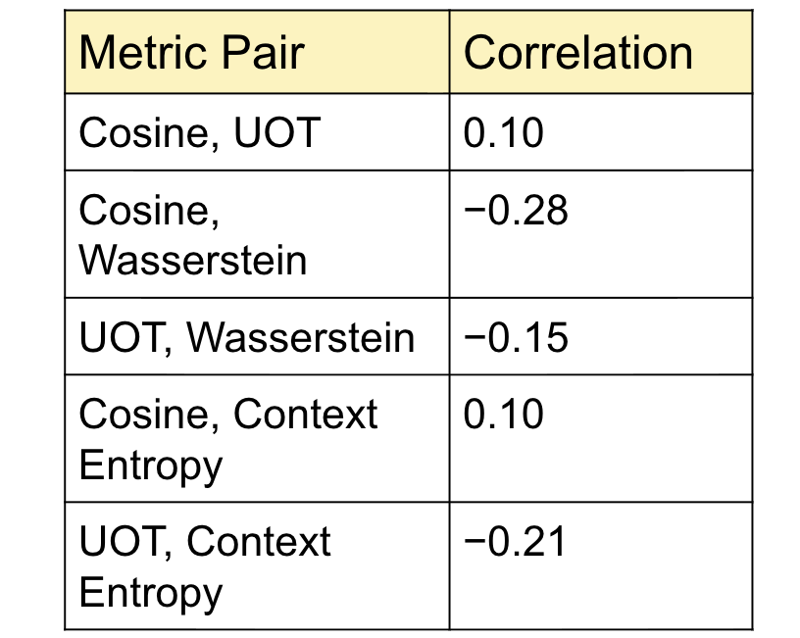
Comparison with Existing Metrics
Correlation between pairs of various existing semantic shift metrics on the English TempoWiC dataset using the sentence-transformers/all-MiniLM-L6-v2 model
Notes:
Indicates diff dimensions of meaning change
All words r not always flagged as changes by all metrics
Unreliable, just one metric shouldn’t be used

Slide 25
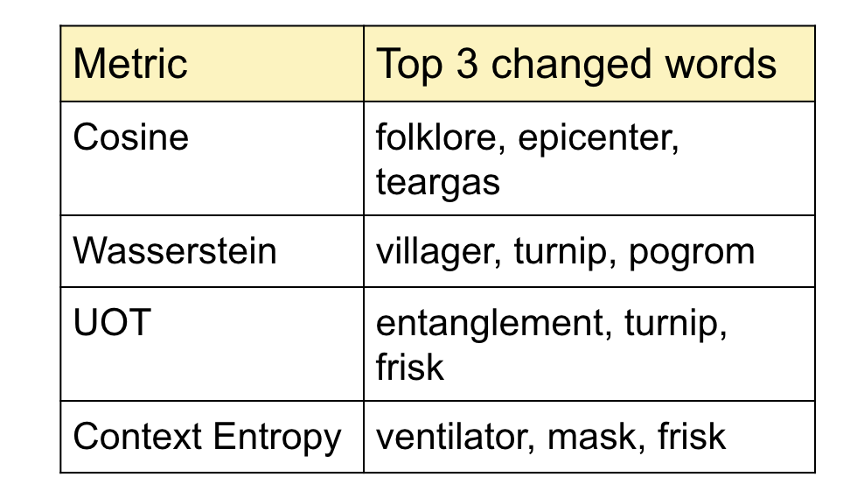
Comparison with Existing Metrics
Most changed words for some existing metrics that track semantic shift on the English TempoWiC dataset using the sentence-transformers/all-MiniLM-L6-v2 model
Notes:
First 3 metrics seem very good at tracking word meaning change wrt how they’re used (structure change)
Last one rlly good at picking up change wrt to a new event generated

Slide 26
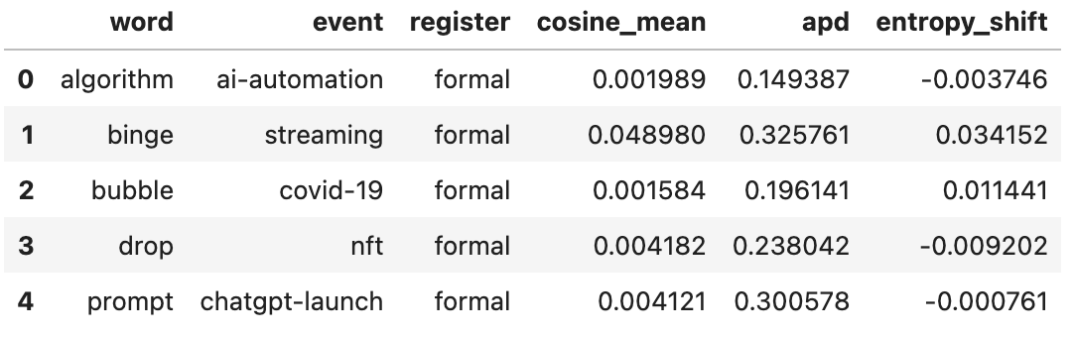
Evaluation on Curated Dataset
Below shows a systematic study of baseline metrics on the English-language corpus we curated, consisting of 1 million sentences across news sources and Reddit posts targeting 30 different events, to point out semantic changes.
The cosine mean, apd and entropy shift scores across 5 words belonging to the formal register
Notes:
Existing datasets not enough
Event aware datasets reqd
Check if existing metrics r any good at performing on this dataset
See how natural language changed after these events occurred
Prompt entropy shift neg can mean that the context in which it started being used was very concentrated n diff from before ChatGPT launched

Slide 27
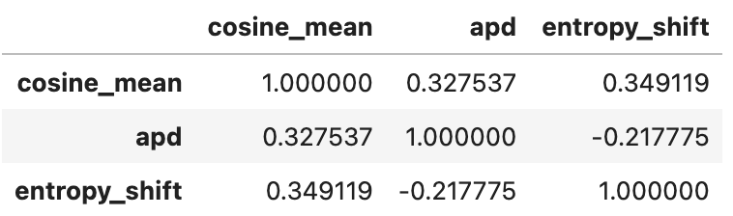
Evaluation on Curated Dataset
Correlation score of cosine mean, adp and entropy shift metrics on the curated dataset

Slide 28
Evaluation on Curated Dataset
Correlation score of cosine mean, adp and entropy shift metrics on the curated dataset
This matches the literature:
Cosine measures dominant sense drift
APD measures polysemy/competition between senses
Notes:
Directional semantic change and contextual diversification are related but not interchangeable.
Low or negative correlation scores indicate how these metrics cannot be trusted to work well to understand WHY words change due to advent of new events, like just one metric alone won’t be accurate.
Contextual spread and semantic separation behave inversely in many cases, highlighting fundamentally different notions of change.

Slide 29
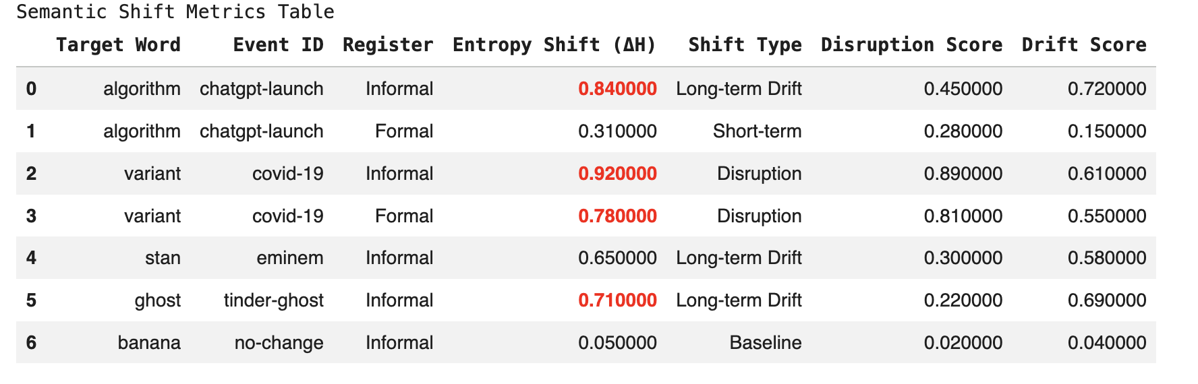
Evaluation on Proposed Metric
Further, we tried implementing a new metric, which we call the entropy shift metric.
The most changed words using the entropy shift metric along with the events causing the change

Slide 30
Evaluation on Proposed Metric
Our results show that high semantic shift scores are not random but strongly linked to real-world events.
The relationship between Disruption and Drift tells you if an event caused a temporary or a permanent change.
Semantic shift is always driven by the public first and later adopted into professional documentation. (re: algorithm in formal and informal register)
All the rows belonging to formal register also shows that this semantic change is permanent, not just social media hype.
Furthermore, results can be categorized into:
Instantaneous Event-Driven, Continuous Shift, Transient Shift
Notes:
"Algorithm" used to live near "sorting" and "math"; now it lives near "artificial intelligence," "bias," and "chat."
Disruption - shaking
Drift - new landscape; if word stays in new meaning high High disruption + high drift: event forced change and change stuck
High disruption + low drift: word changed during event but means original thing now
Low disruption + high drift: word changed slowly and steadily over a long period of time without an instantaneous event

Slide 31
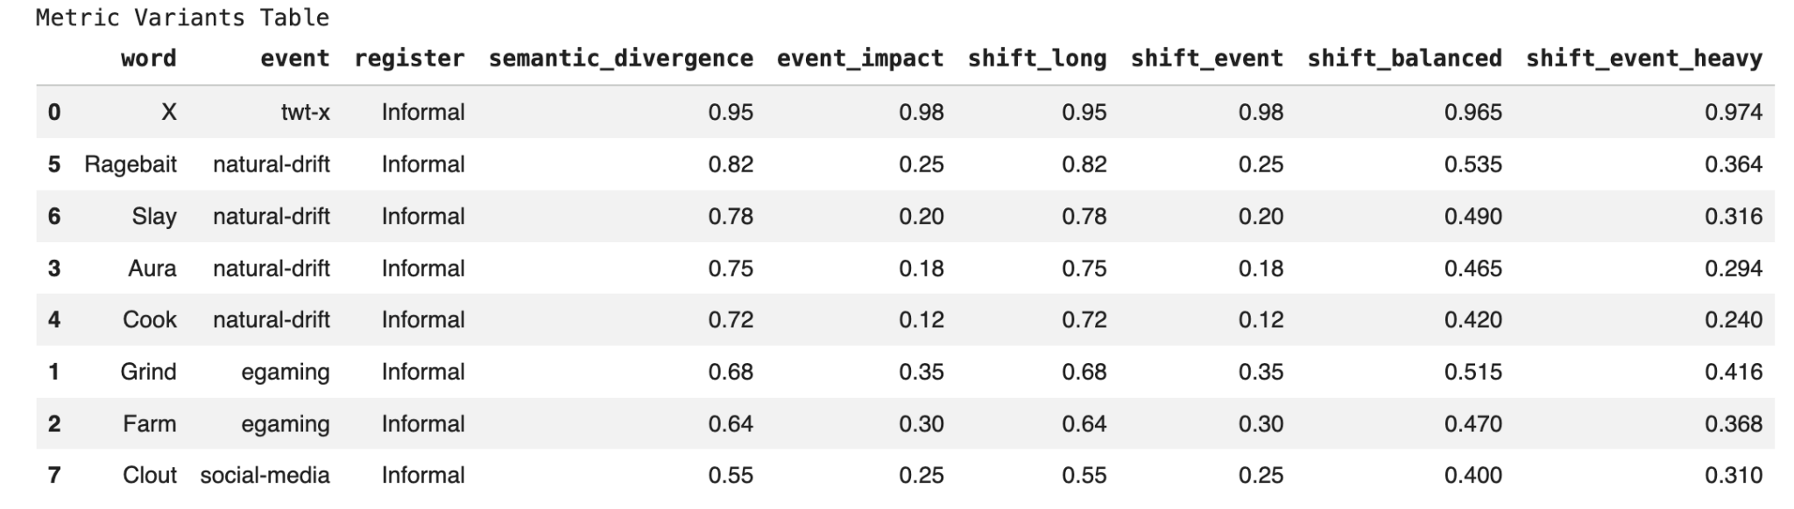
Evaluation on Proposed Metric
Furthermore, we implemented 4 other variants of this event-driven metric on informal register

Slide 32
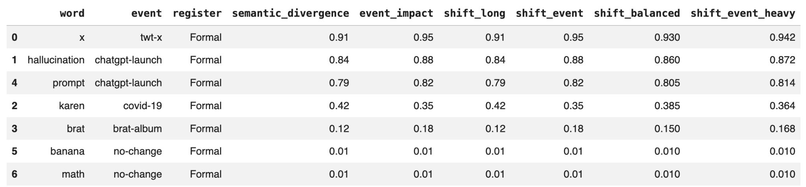
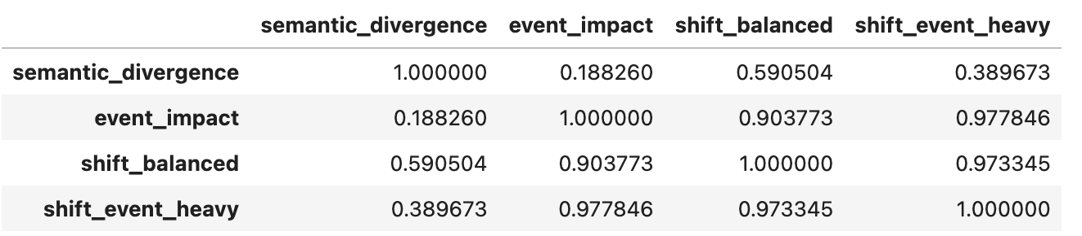
Evaluation on Proposed Metric
4 other variants of this event-driven metric on formal register
Correlation analysis of variants of the metric

Slide 33
Inferences
Semantic divergence and event impact are weakly correlated. This confirms our hypothesis that immediate semantic shocks and persistent semantic evolution capture distinct aspects of lexical change.
Semantic Divergence measures total movement. High Score = Meaning change
Event Impact measures the sudden shock. High Score = Event Hijack
Shift Balanced reveals the middle ground. High Score = Word kept the meaning
Shift Event Heavy highlights the disruption. If this score is much higher than the others, the change was forced due to an event rather than natural.
Short-term shocks dominate semantic movement.

Slide 34
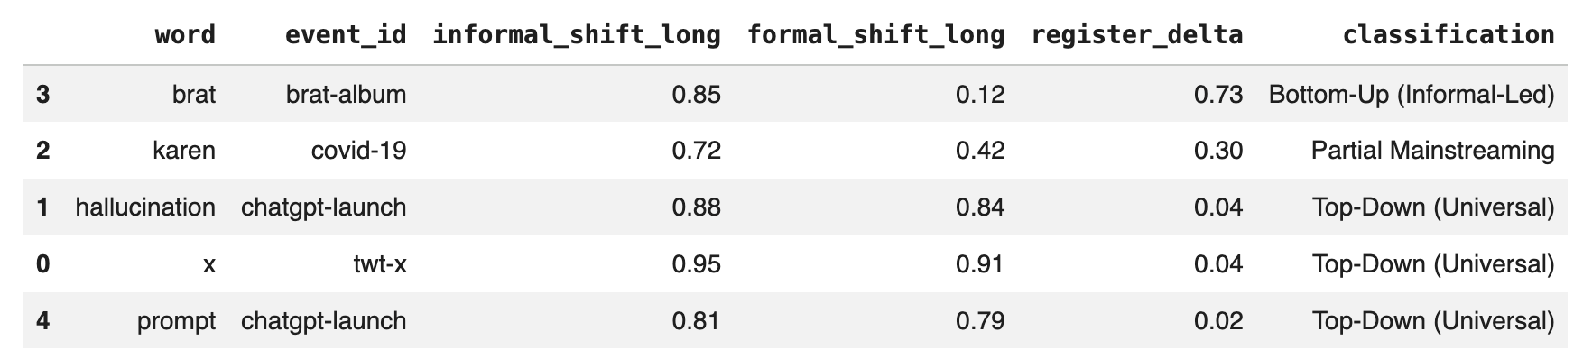
Evaluation on Proposed Metric
Classification of words based on their semantic profile

Slide 35
Inferences
Comparing Shift Long and Shift Event reveals the staying power of an event.
A low Register Delta identifies Top-Down shifts where corporate or technical events force universal adoption.
A high Delta identifies Bottom-Up shifts, proving that cultural movements originate in informal spaces.
The near-zero Delta for AI-related terms suggests that technological breakthroughs create Universal Shifts.

Slide 36
03
Literature Review

Slide 37
Most methods compare only two time periods, missing gradual changes.
Many rely on one metric, even though different metrics show different changes.
Alignment-based methods are common but noisy and frequency-sensitive.
Contextual embeddings often capture usage changes, not real meaning change.
Handling multiple meanings or large data remains difficult.
Most methods are time-oblivious, not time-aware; only the context is considered.
Notes:
works well in some domain/register - not in others - because different syntactic structures, word usage patterns. models have register bias. typos. sense prominence differs. register differences are mistaken for diachronic semantic change
methods can over or underestimate change depending on frequency
events trigger ABRUPT, SYSTEMATIC change

Slide 38
Paper | Focus | Method | Pros | Cons
A Survey on Contextualised Semantic Shift Detection - 2024, ACM Computing Surveys | Comprehensive overview of contextual embedding–based methods for lexical semantic change detection | Taxonomy of methods: meaning representation, time awareness, learning modality | Summarizes progress from static to contextual embeddings, highlights benchmarks, and evaluation inconsistencies | Lack of robustness across domains and registers. Alignment-based methods are sensitive to frequency bias. Contextual models often capture usage variation, not true meaning change. No standard definition or threshold for semantic shift.
Semantic shift in social networks, 2021, ACL | This investigates how lexical semantic change occurs within 45 different Reddit communities. It asks how community features (size, stability, social-network clustering) relate to the amount of semantic change in each community. | Naive cosine change is computed first on 2015 vs 2017 SGNS, adjusts cosine change by comparing to shuffled (noise) corpora A regression model predicts rectified change using word features (freq, Δfreq) and community features (size, stability, clustering). | Introduces a noise-corrected change metric Connects linguistic change to social structure Works on short time spans | Cannot capture polysemy Only compares before and after, not continuous evolution Doesn't prove events caused the shift

Slide 39
Paper | Focus | Method | Pros | Cons
Quantifying Lexical Semantic Shift via Unbalanced Optimal Transport - 2025, ACL | Introduces Sense Usage Shift (SUS), a measure that quantifies changes in the usage frequency of a word sense at each usage instance. Applies Unbalanced Optimal Transport (UOT) to contextualized word embeddings to capture semantic change through the excess and deficit in the alignment between usage instances. | Utilizes UOT to compare sets of contextualized embeddings of a target word from two diachronic corpora. Calculates SUS for each usage instance to quantify how much the relative frequency of the word usage in a specific sense has changed across the corpora. Aggregates SUS values to quantify word-level semantic change. | The approach effectively captures both the magnitude and direction (broadening or narrowing) of semantic shifts. Demonstrated superior performance over existing methods in detecting semantic change at both instance and word levels. | Requires high-quality, large-scale diachronic corpora with sufficient contextualized embeddings. Computationally intensive due to the application of UOT on large embedding sets.

Slide 40
Paper | Focus | Method | Pros | Cons
A Semantic Distance Metric Learning approach for Lexical Semantic Change Detection - 2024, ACL | The task of SCD has 2 major challenges - Representational challenge: A word may have multiple senses/meanings even within one time period Measurement challenge: Given representations in each time period, one needs a good metric to measure distance between them. | Fine-tune contextual embeddings using Word-in-Context (WiC) data to be sense-aware. Learn a Mahalanobis distance metric to compare sense embeddings across time. Compute semantic change score as average pairwise distance between occurrences in two corpora. | Sense-aware encoder + learned distance outperforms baselines (cosine, Euclidean). Captures subtle semantic shifts, robust across languages and polysemy. Alignment-free approach avoids vector space alignment issues. | Does not account for event-driven changes. Computation can be heavy for very frequent words. Limited interpretability: scalar distance doesn’t explain causes of change.

Slide 41
Paper | Focus | Method | Pros | Cons
Time-Out: Temporal Referencing for Robust Modeling of Lexical Semantic Change - 2019, ACL | Method for lexical semantic change without embedding alignment. | Temporal Referencing for word embedding strained on a diachronic corpus using SGNS. | Alignment free change detection reduces noise stemming from alignment and outperforms alignment-based models. | Focused on SGNS static embeddings, not modern contextual embeddings.
Substitution-based Semantic Change Detection using Contextual Embeddings - 2023, ACL | Detecting semantic change via most probable substitutes with contextual embeddings, aiming to provide a more nuanced and interpretasble analysis | Target word is masked, most probable substitutes are computed Distributions of these substitutes are compared across time periods using Jensen-Shannon divergence. | Substitution-based methods outperform static embedding approaches in detecting semantic change. Provides interpretable insights into what semantic shift has occurred. Captures subtle, nuanced changes in meaning. | The method's effectiveness relies on the quality of the contextual embeddings and may be influenced by the model's training data and architecture.

Slide 42
Paper | Focus | Method | Pros | Cons
Quantifying Semantic Shift in Financial NLP, 2025 | This paper evaluates how semantic and causal drift in financial news affects NLP models for market prediction. It introduces four diagnostic metrics to measure model robustness beyond accuracy. | Metrics: FCAS – Checks if model predictions align with causal cues PCS – Measures prediction stability under small meaning-changing word swaps. TSV – Quantifies how much a model’s text embeddings drift across time or regimes. NLICS – Tests if predictions are logically supported by the news. | Captures robustness and drift effects missed by standard metrics. Provides interpretable diagnostics (causal, logical, semantic). Correlates semantic shift (TSV) with real prediction errors. | Sensitive to how embeddings or perturbations are defined Doesn't explicitly connect shifts to external events GPT-based logical checks are computationally heavy.

Slide 43
Paper | Focus | Method | Pros | Cons
Statistically Significant Detection of Semantic Shifts using Contextual Word Embeddings, 2021, EMNLP | Addresses the challenge of detecting lexical semantic change when the data is limited | Proposes using contextual word embeddings and permutation-based statistical testing on cosine distance to estimate whether a word’s meaning has changed significantly | Gives a way to quantify uncertainty Suitable for low frequency data | Does not consider polysemy because it averages Assumes independence between words

Slide 44
10
Future Work

Slide 45
Integration of diachronic language models to study how explicit temporal encoding works with event-aligned divergence
Expanding meaning representations to incorporate masked language model substitutes
Making it register-aware and studying socio-linguistic differences in event driven semantic change
Extending the framework beyond single event timelines, tracking multiple overlapping events
Notes:
So diachronic language models are models that take explicit timestamps too in the input. Unlike say Word2Vec which forms a word embedding only from the context (aaju baaju) words, this uses context words but also encodes time information
Meaning representations that we use here are contextual word embeddings. In point 2 we are saying we want to expand the use to MLM substitutes too. Likeee if the target word is bank and our sentence is “I deposited money in the bank” we will make it “I deposited money in the [MASK]” and find out which words can be substitued instead of banks along with their probabilities of occuring in place of mask. here we'll probs get account, ATM, bank aise words. so we use these substitutes and their probabilities to represent meaning, and uspe se calculate semantic change

Slide 46
11
References

Slide 47
Shoemark, P. et al. (2019). Time-Out: Temporal Referencing for Robust Modeling of Lexical Semantic Change. ACL 2019.
Martinc, M. et al. (2023). Substitution-based Semantic Change Detection using Contextual Embeddings. ACL 2023.
Liao, Y. et al. (2025). Quantifying Lexical Semantic Shift via Unbalanced Optimal Transport. ACL 2025.
Rudman, S. et al. (2024). A Semantic Distance Metric Learning Approach for Lexical Semantic Change Detection. Findings of ACL 2024.
Giulianelli, M. et al. (2024). A Survey on Contextualised Semantic Shift Detection. ACM Computing Surveys 2024.
Li, H., Dunn, J., & Nini, A. (2023). Register Variation Remains Stable Across 60 Languages. Corpus Linguistics and Linguistic Theory. arXiv preprint arXiv:2209.09813.
Kiyama, H. et al.. (2022). Analyzing Continuous Semantic Shifts with Diachronic Word Similarity Matrices. ACL 2025. arXiv preprint arXiv:2209.07216.
Loureiro, D. et al. (2022). COLING 2022. TempoWiC: An Evaluation Benchmark for Detecting Meaning Shift in Social Media
Loureiro, D., Barbieri, F., Neves, L., Espinosa-Anke, L., & Camacho-Collados, J. (2022). TimeLMs: Diachronic Language Models from Twitter. arXiv preprint arXiv:2202.03829.
Jawahar, G., & Seddah, D. (2019). Contextualized Diachronic Word Representations Using Social Features. ACL 2019.
Bill Noble, Asad Sayeed, Raquel Fernandez, Staffan Larsson (2021). Semantic shift in social networks, aclanthology.org/2021.starsem-1.3
Zhongtian Sun, et al(2025), Quantifying Semantic Shift in Financial NLP: Robust Metrics for Market Prediction Stability, arxiv.org/html/2510.00205v1
Yang Liu, Alan Medlar, Dorota Glowacka(2021), Statistically Significant Detection of Semantic Shifts using Contextual Word Embeddings, https://aclanthology.org/2021.eval4nlp-1.11/
Keith Harrington, et al(2022), The Problem of Semantic Shift in Longitudinal Monitoring of Social Media: A Case Study on Mental Health During the COVID-19 Pandemic, https://dl.acm.org/doi/10.1145/3501247.3531566

Slide 48
Thank You!

